Slide 1
Lecture notes Chapter 3: Control Statement

Slide 2

Welcome!!
“
Logic is the beginning of wisdom, not the end.
”
Leonard Nimoy

Slide 3
Chapter Overview
Decision-making statement
Including if, if-else, if-else if and switch
01
Nested decision-making statement
Including nested if
02
Control Flow statement
Including while, do while, for loop
03
Nested Control Flow statement
Including nested loop
04

Slide 4
Decision making statement
The programs that we discussed is last lecture notes are just a linear sequence of statements. However, when a program is processing, we may want it to make decisions or even repeat under different circumstances. The C++ language enable us to pull this out by using decision-making or control flow statements.
If statement
If-else statement
If-else-if statement
Switch statement
It tells the computer to execute certain statement when condition is satisfied.
It tells the do(s) and don’t(s) to computer according to the condition.
Similar to if-else statement but with more conditions and statements.
It allows a variable to be tested for equality against a list of values.
More on the next page

Slide 5
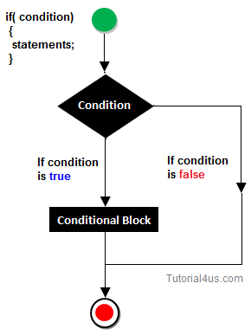
If statement
The first decision-making statement we introduce is if statement:
The format of if is
if ( condition ) { statement(s); }
When we execute the if statement, the computer will check whether
the condition is satisfied of not. If and only if the condition is satisfied
(true), the statement block will execute. If the condition is not satisfied
(false), the statement will not execute.
** You may refer back to Relational Operators and Logical Operators in Chapter 2 notes if you have forgotten what we mean by true or false.

Slide 6
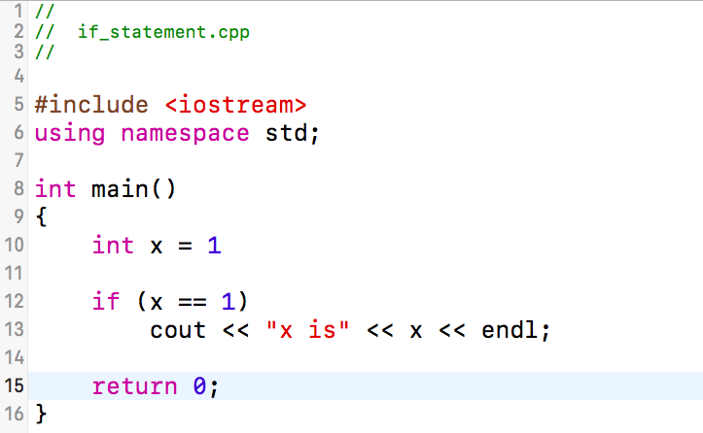
if_statement.cpp
Run the program in the console and find out what the output is.
You can also try to change the condition to see whether the same result will be executed.

Slide 7
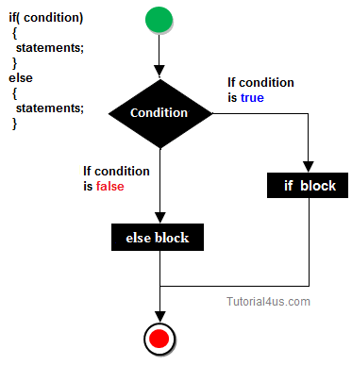
If-else statement
The second decision-making statement we introduce is if-else statement:
The format of if is
if ( condition ) { statement(s); } else { statement(s); }
When we execute the if-else statement, the computer will check whether
the condition is satisfied of not. If and only if the condition is satisfied
(true), the first statement block will execute. If the condition is not
satisfied (false), the statement block after the else will execute.

Slide 8
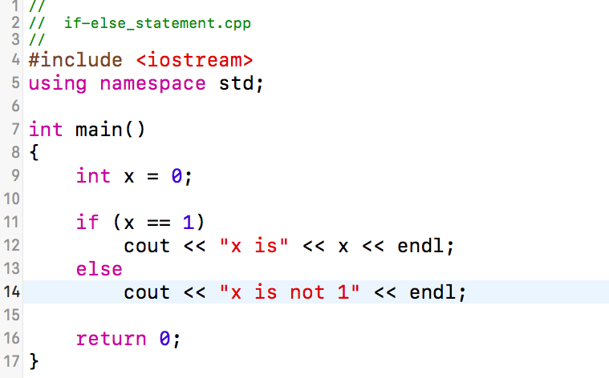
if-else_statement.cpp
Run the program in the console and find out what the output is.
You can also try to change the condition to see whether the same result will be executed.

Slide 9
If-else-if statement
The third decision-making statement we introduce is if-else-if statement:
The format of if is
if ( condition ) { statement(s); }
else if ( condition ) { statement(s); }
else if ( condition ) { statement(s); }…
Similar to if-else, when we execute the if-else-if statement, the computer will check whether the first condition is satisfied of not. If and only if the condition is satisfied (true), the statement block following will execute. If the condition is not satisfied (false), the computer will then go to the next condition until it finds a satisfied one. If no condition is satisfied, none of the statements written will executed.
** Please be reminded that once an else-if condition is satisfied, only the following statement will execute and none of the remaining condition will be tested

Slide 10
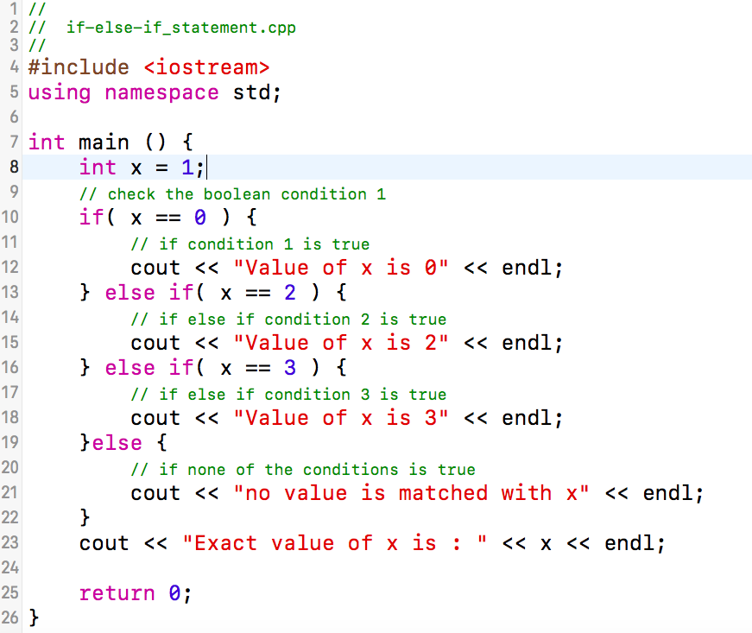
If-else-if.cpp
Run the program in the console and find out what the output is.
You can also try to change the condition to see whether the same result will be executed.

Slide 11
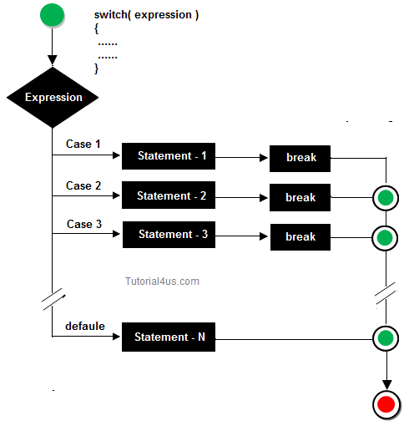
Switch statement
The forth decision-making statement we introduce is switch statement:
The format of if is
Switch (variable / expression){
case value: statements; break;
case value: statements; break;…
default: statements;}
Similar to if-else-if, when we execute the switch statement, the computer will check whether the expression is satisfied of not. If and only if the expression is matched, the statement block after that particular case will execute. The program will then break which means that the remaining cases will not be tested. If the expression is not matched, the computer will look for the remaining cases until it find one. If no case is matched, the statement block of default case will be execute. There is no limit of case you want to add.

Slide 12
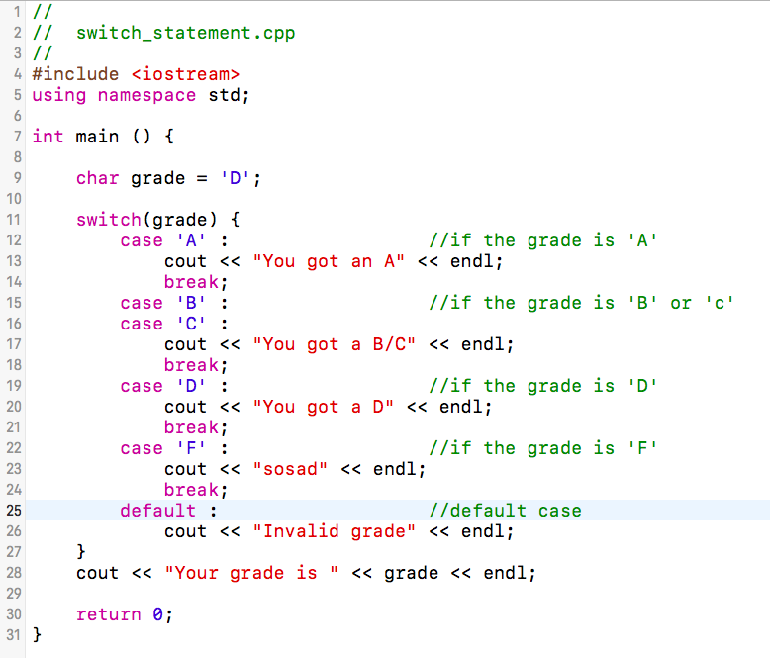
switch.cpp
Run the program in the console and find out what the output is.
You can also try to change the condition to see whether the same result will be executed.

Slide 13
Nested-if statement
The fifth decision-making statement we introduce is nested-if statement:
The format of if is
if ( condition 1 ){ statement 1;
if ( condition 2 ) { statement 2;}…}
With nested structure, we can put an if-statement inside another if-statement. When we execute the program the condition 1 will be tested, if the condition is false, no any remaining conditions or statements will execute. If the condition is true, statement 1 will execute. After that condition 2 will be tested, similar to before, if the condition is true, the statement 2 will execute. If not, no remaining conditions or statements will execute. There is no limit of if statements you can nest is the nested-if statement.

Slide 14
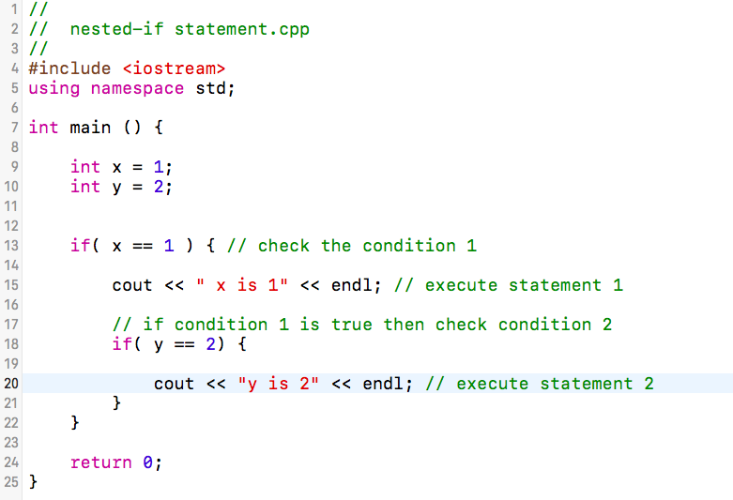
nested-if.cpp
Run the program in the console and find out what the output is.
You can also try to change the condition to see whether the same result will be executed.

Slide 15
Control Flow statement
When a program is processing, we may want it to repeat under certain circumstances. The C++ language enable us to pull this out by using control flow statements.
while loop
Do-while loop
For loop
The program will
continue repeating
when the condition given is false.
Similar to while loop, but will always execute at least one time before checking the condition.
Similar to while loop, but we can control the number of repeats.
More on the next page

Slide 16
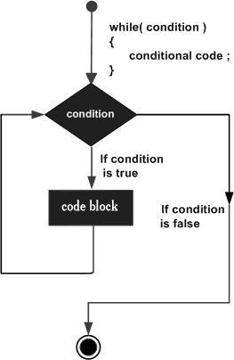
While loop
The first control flow statement we introduce is while loop.
The format of if is
while ( condition ) { statement(s); }
When execute the program, we first test the condition. If the condition is false, the statement will not execute and will not test the condition again. If the condition is true, the statement will execute. After that, we will test the condition again until the condition is false.
** Remember to check the following example to see how we prevent from falling into infinite loop.

Slide 17
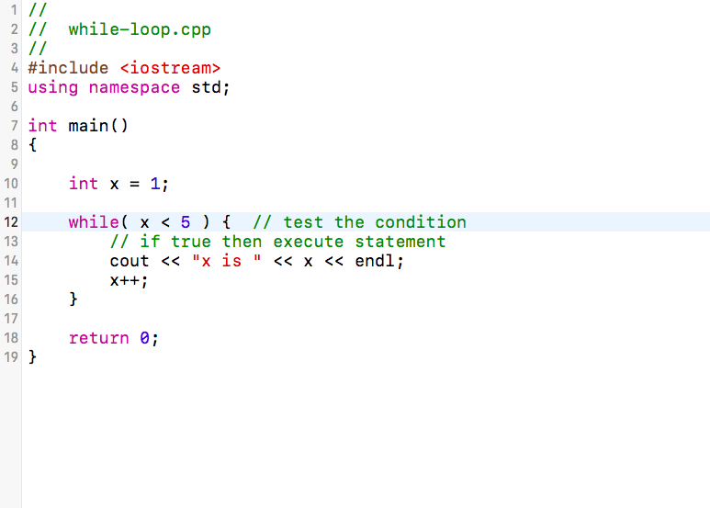
while-loop.cpp
Run the program in the console and find out what the output is.
You can also try to change the condition to see whether the same result will be executed or going into infinite loop.

Slide 18
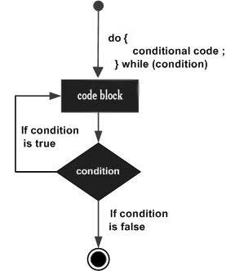
Do-while loop
The second control flow statement we introduce is while loop.
The format of if is
do { statement(s); } while ( condition)
When execute the program, we first execute the statement, then check the condition. If the condition is false, the do-statement block will not execute again and will not test the condition again. If the condition is true, the do-statement will execute again until the condition is false.

Slide 19
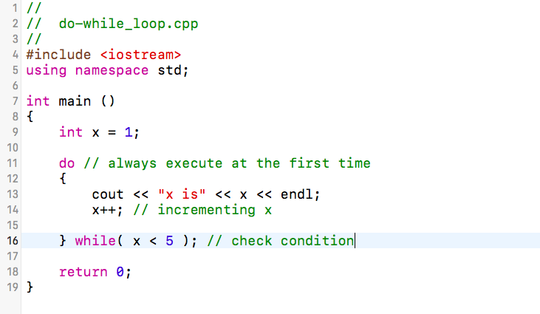
do-while-loop.cpp
Run the program in the console and find out what the output is. Try to compare it with the previous exercise and try to think why they are the same?
You can also try to change the condition to see whether the same result will be executed or going into infinite loop.

Slide 20
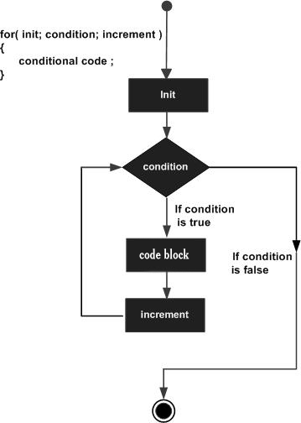
For loop
The third control flow statement we introduce is for loop.
The format of if is
for ( initialization; condition; after process) {statement(s);}
When execute the program, we first do the initialization of a variable which is the counter. We then check the condition whether it is true or not. If false, no statements or condition will be execute. If true, the statements will execute. After that, the after process (usually the variable initialize before) will also execute. The flow will then jump back to the testing of condition until the condition is false.

Slide 21
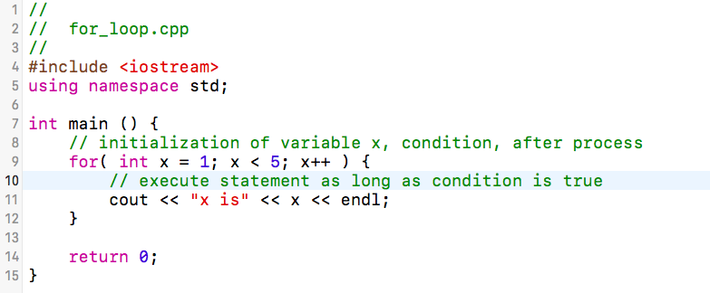
for-loop.cpp
Run the program in the console and find out what the output is.
You can also try to change the condition, initialization or the after process to see whether the same result will be executed or going into infinite loop.

Slide 22
Nested loop
The forth control flow we introduce is nested loop. Please be reminded that we can write nested while loop and for loop. We are able to put a loop inside another loop just like nested if before, and we call this nested loop.
The format is
for ( initialization; condition; after process ) {
for ( initialization; condition; after process ) { statement(s); }
statement(s);…} // this is a nested for loop
When we execute the program, it will undergo the process just like the same as normal for loop. However, the computer will then go into the inner loop and looping the inner statement(s) before executing the outer statement(s).

Slide 23
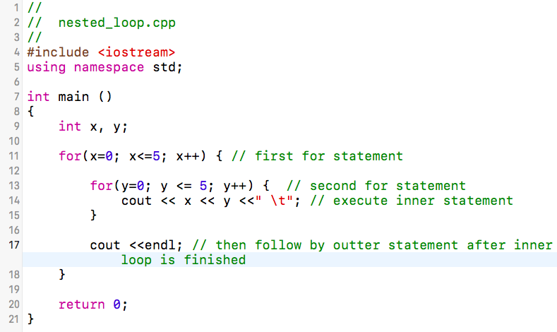
nested-loop.cpp
Run the program in the console and find out what the output is.
You can also try to change the condition, initialization or the after process to see whether the same result will be executed or going into infinite loop.

Slide 24

Break and Continue
During a loop, we sometimes want to terminate or continue it according to our own will. At this time, break and continue will become handy under those situations.
Break statement is used to force the termination of the loop statement and switch case statement. (recall back to lecture notes 2). We can place break; wherever we want the loop to end and stop repeating. You may see the example in the next slide.
Continue statement is used to forces the next loop to take place instantly, skipping the remaining code in between. Similar to break;, we can put continue; wherever we want to skip the remaining code and instantly go to the next iteration of loop. You may see the example in the next slide.
** Remember that both break and continue only apply to the inner most loop!

Slide 25
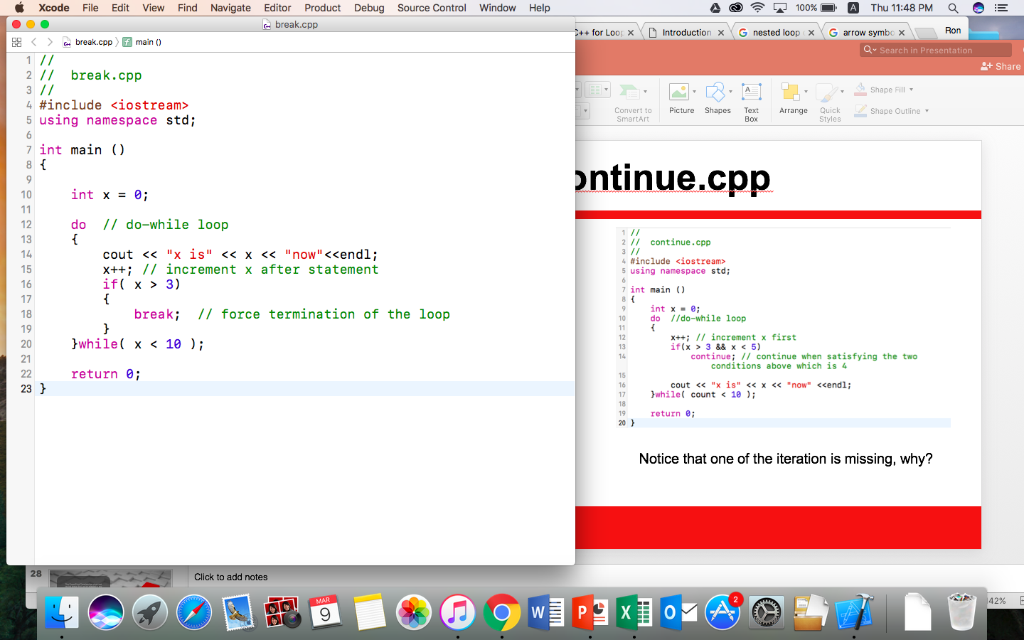
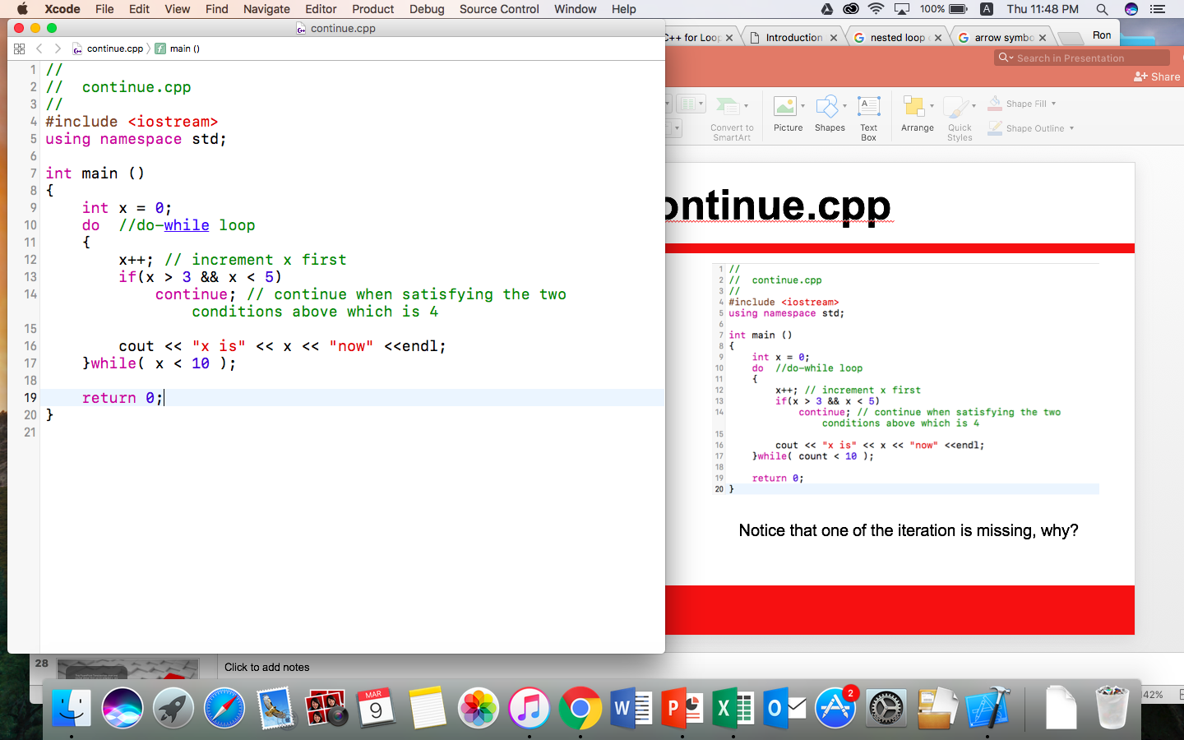
break.cpp and continue.cpp
What is the output of this program, why?
Notice that one of the iteration is missing, why?

Slide 26
Want to know more?
Go to the next chapter!

